Slide 1
The CS-8001 Series ONU Products

Slide 2

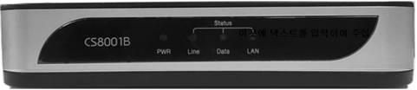
Front View
CS-8001A
CS-8001B

Slide 3
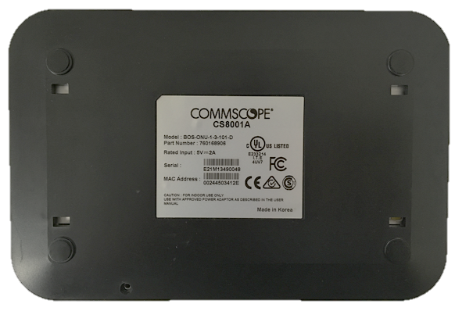
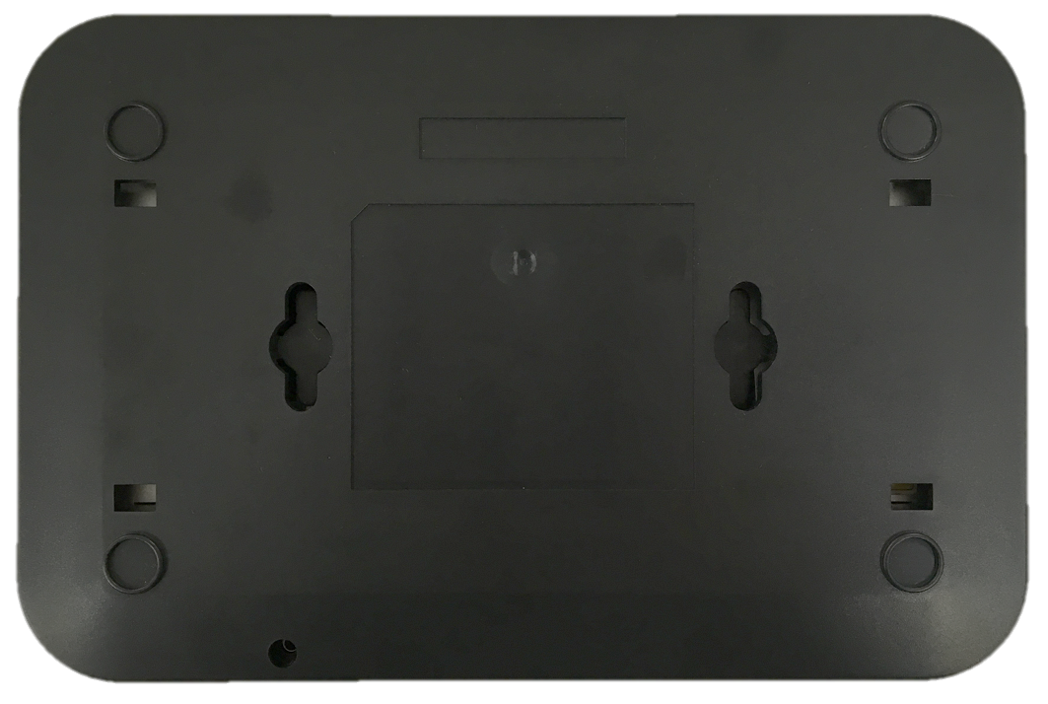
Bottom View
CS-8001A
CS-8001B
Features 2 mounting holes for wall mount application.

Slide 4
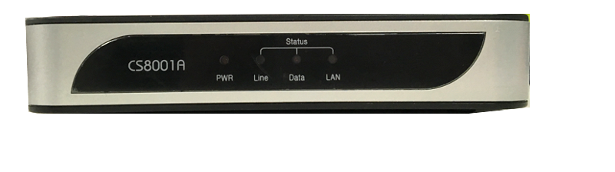
Bottom Panel Height
CS-8001A
CS-8001B
Height: 0.08 in (0.22 cm)
Height: 0.25 in (0.65 cm)

Slide 5

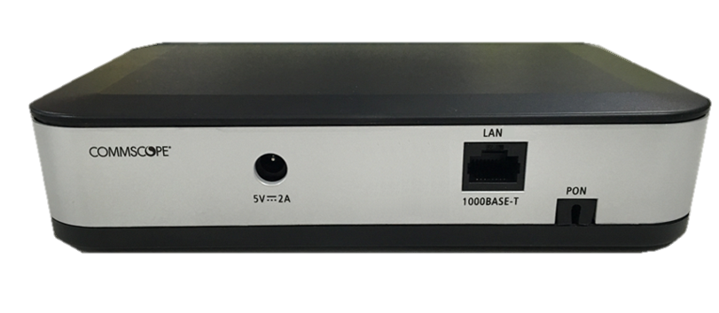
Rear View
CS-8001A
CS-8001B

Slide 6
Product Comparison
Features | CS-8001A | CS-8001B
LAN Port | 1 10/100/1000Base-T port | 1 10/100/1000Base-T port
LED Indicators | PWR LED - Power Off : OFF - Power On : Solid green LAN (Link/Act) - Solid green/blinking green | PWR LED - Power Off : OFF - During bootup : Solid amber - During F/W download : Blinking amber - After F/W download : Solid green LAN (Link/Act) - GE : Solid green/blinking green
Fiber Type | SC/APC | SC/APC
Power Switch | Built-in | Removed
Advanced Functionalities |  | DDM (Digital Diagnostics Monitoring) Enables the LAN port only if the PON link is connected Automatically detects & shuts down abnormal operations of the optical transceiver

Slide 7
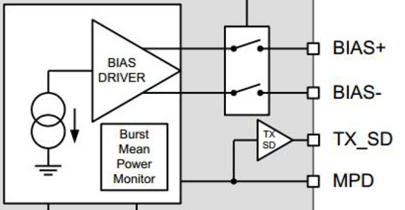
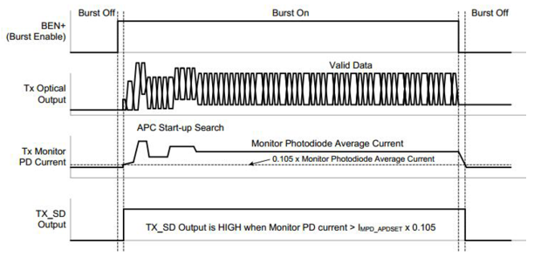
Automatic Detection & Shutdown of Optical Transceiver
If an ONU continues to transmit optical signals after a certain amount of time passes, the MICOM (ONU CPU) determines that a failure has occurred in the optical transceiver and shuts it down.
The ONU transmits data for the amount of time specified by the OLT.
In terms of TX_SD, output is HIGH while sending data; output is LOW once data transmission stops.
While sending data, the electric current of photodiode reaches a threshold value and TX_SD output becomes HIGH.
If TX_SD output continues to remain HIGH after the specified amount of time passes, the MICOM blocks power from the optical transceiver.
This function is implemented on the ONU board based on patented technology of CommScope.

